Slide 1
Deep Learning: Neural Network Basic
June 2019

Slide 2
Outline
Visualize training process
Underfitting vs Overfitting
How to prevent Overfitting
Keras: Miscellanious

Slide 3
Neural Networks in Practice: Visualize training process

Slide 4
Visualizing training process
Access Model Training History in Keras
history = model.fit(X, Y,
# list all data in history
print(history.history.keys())
Access Model Training History in Keras
plt.plot(history.history['acc’])
plt.plot(history.history['val_acc’])
plt.plot(history.history['loss’])
plt.plot(history.history['val_loss'])
https://machinelearningmastery.com/display-deep-learning-model-training-history-in-keras/

Slide 5
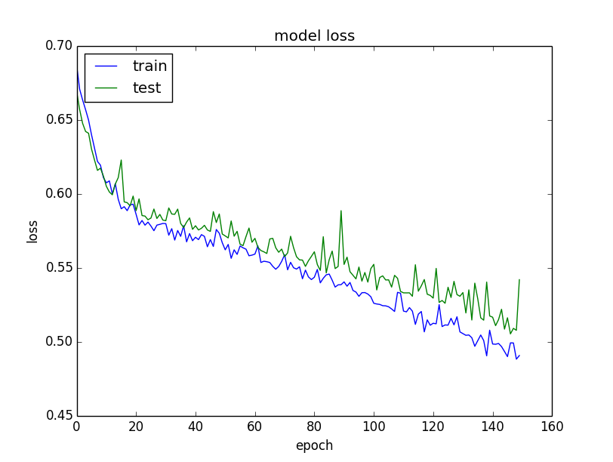
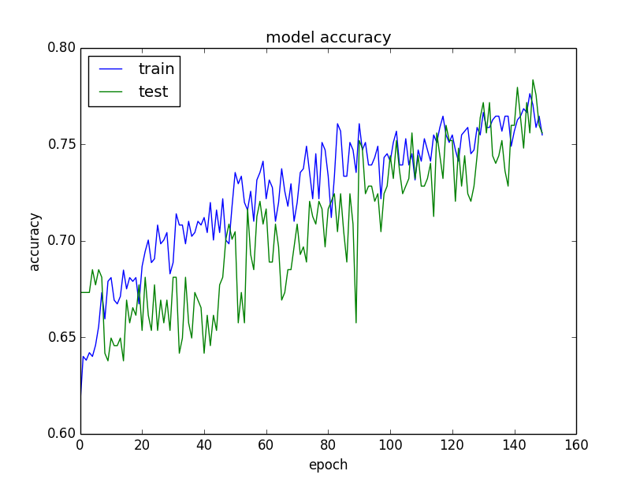
Loss vs Accuracy
Loss
Accuracy

Slide 6
Live tracking
from matplotlib import pyplot as plt from IPython.display import clear_output
class PlotLosses(Callback): def on_train_begin(self, logs={}): self.i = 0 self.x = [] self.losses = [] self.val_losses = [] self.fig = plt.figure() self.logs = [] def on_epoch_end(self, epoch, logs={}): self.logs.append(logs) self.x.append(self.i) self.losses.append(logs.get('loss')) self.val_losses.append(logs.get('val_loss')) self.i += 1 clear_output(wait=True) plt.plot(self.x, self.losses, label="loss") plt.plot(self.x, self.val_losses, label="val_loss") plt.legend() plt.show();

Slide 7
Neural Networks in Practice: Underfitting vs Overfitting

Slide 8
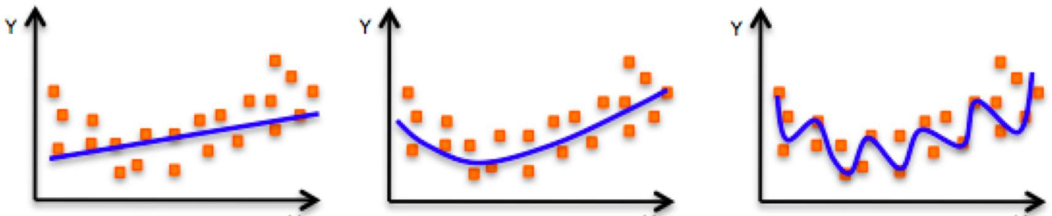
The Problem of Overfitting
Underfitting
Model does not have capacity to fully learn the data
Ideal fit
Overfitting
Too complex, extra parameters, does not generalize well

Slide 9
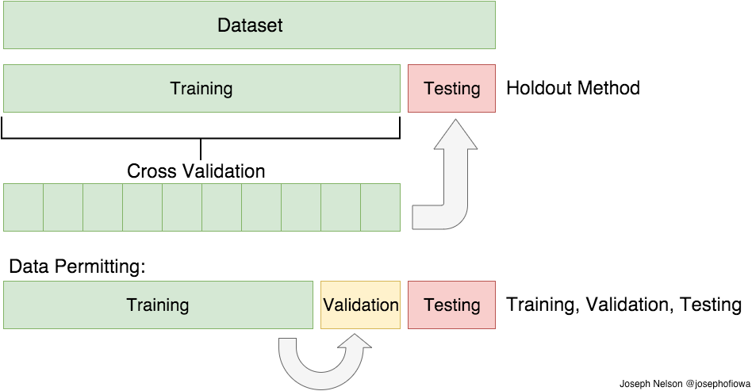
Training and Testing Data

Slide 10
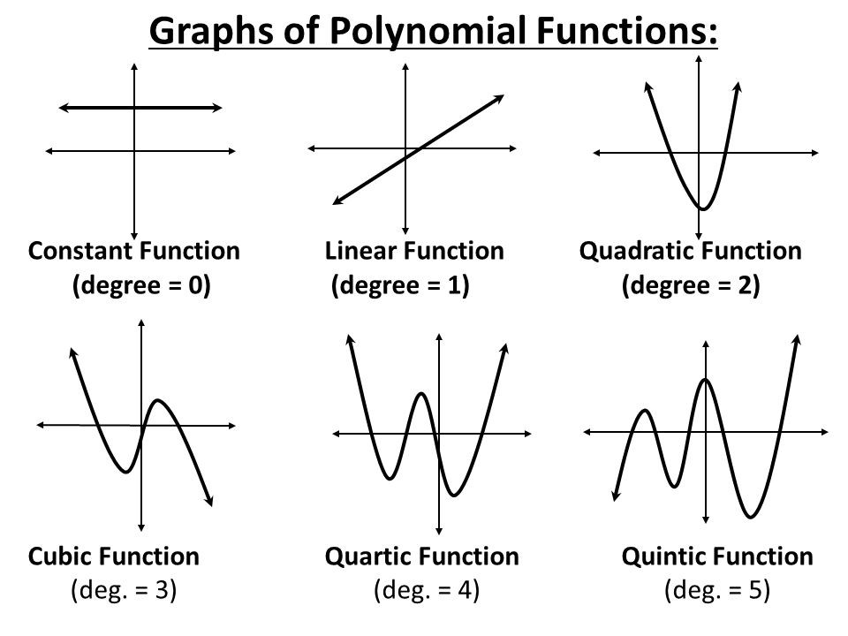
Model Building
Choosing a model can seem intimidating, the good rule is to start from the simple model.

Slide 11
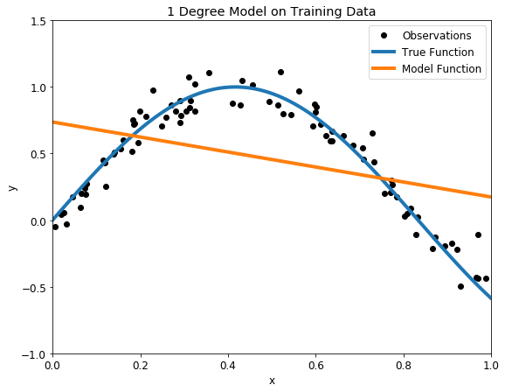
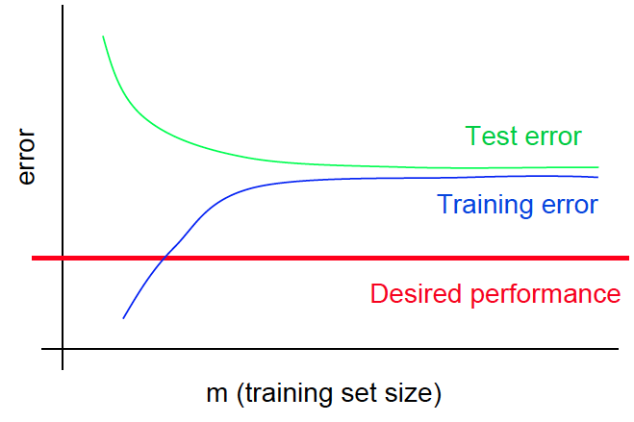
Underfitting – high bias
Notes:
We saw a low degree leads to underfitting. A natural conclusion would be to learn the training data, we should just increase the degree of the model to capture every change in the data. This however is not the best decision!

Slide 12
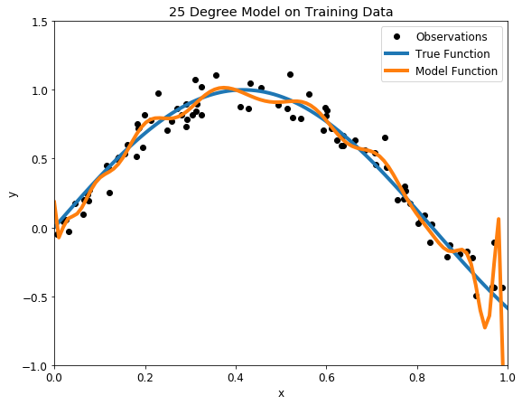
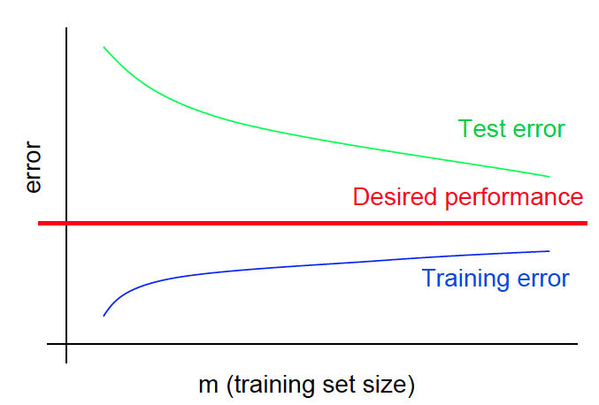
Overfitting - high variance
We want a model that learns the actual relationship, not “memorize” the training data!

Slide 13
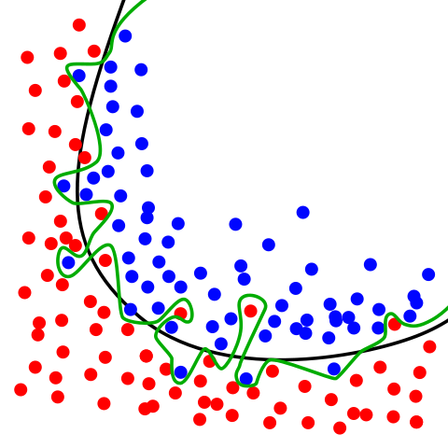
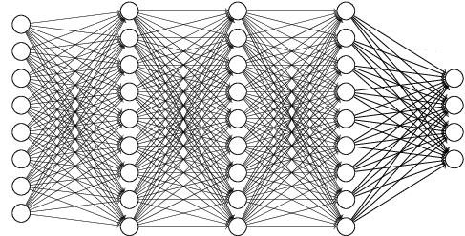
Current Trend in Building Model
As a general rule: Start by overfitting the model, then take measures against overfitting.

Slide 14
Neural Networks in Practice: How to prevent Overfitting

Slide 15
Regularization
What is it?
Technique that constrains our optimization problem to discourage complex models

Slide 16
Regularization
What is it?
Technique that constrains our optimization problem to discourage complex models
Why do we need it?
Improve generalization of our model on unseen data

Slide 17


Parameter Regularization
$$λ\sum_{j=1}^{m}{\left|w_{j}\right|}$$
L1 regularization
L2 regularization
$$λ\sum_{j=1}^{m}{w_{j}^{2}}$$
$$J\left(W\right)= −\frac{1}{n}\sum_{i=1}^{n}{\left[y^{\left(i\right)}\log\left(f\left(x^{\left(i\right)};W\right)\right)+\left(1−y^{\left(i\right)}\right)\log\left(1−f\left(x^{\left(i\right)};W\right)\right)\right]}+λ\sum_{j=1}^{m}{w_{j}^{2}}$$

Slide 18
Parameter Regularization
Example
from keras import regularizers
model.add(Dense(64, input_dim=64, kernel_regularizer=regularizers.l2(0.01)))
Available penalties
keras.regularizers.l1(0.01)
keras.regularizers.l2(0.01)
keras.regularizers.l1_l2(l1=0.01, l2=0.01)
Developing new regularizers
More detail https://keras.io/regularizers/

Slide 19













Dropout
During training, randomly set some activations to 0
$$y_{1,1}$$
$$y_{2,1}$$
$$x_{1}$$
$$y_{1,2}$$
$$y_{2,2}$$
$${\hat{y}}_{1}$$
$$x_{2}$$
$$y_{1,3}$$
$$y_{2,3}$$
$${\hat{y}}_{2}$$
$$x_{3}$$
$$y_{1,4}$$
$$y_{2,4}$$

Slide 20

Dropout
During training, randomly set some activations to 0
Typically ‘drop’ 50% of activations in layer
Forces network to not rely on any 1 node
tf.keras.layers.Dropout(p=0.5)
$$y_{1,1}$$
$$y_{2,1}$$
$$x_{1}$$
$$y_{1,2}$$
$$y_{2,2}$$
$${\hat{y}}_{1}$$
$$x_{2}$$
$$y_{1,3}$$
$$y_{2,3}$$
$${\hat{y}}_{2}$$
$$x_{3}$$
$$y_{1,4}$$
$$y_{2,4}$$

Slide 21
Dropout
During training, randomly set some activations to 0
Typically ‘drop’ 50% of activations in layer
Forces network to not rely on any 1 node
tf.keras.layers.Dropout(p=0.5)
$$y_{1,1}$$
$$y_{2,1}$$
$$x_{1}$$
$$y_{1,2}$$
$$y_{2,2}$$
$${\hat{y}}_{1}$$
$$x_{2}$$
$$y_{1,3}$$
$$y_{2,3}$$
$${\hat{y}}_{2}$$
$$x_{3}$$
$$y_{1,4}$$
$$y_{2,4}$$

Slide 22
Tips for using Dropout
Generally, use a small dropout value of 20%-50% of neurons with 20% providing a good starting point.
Use a larger network.
Use dropout on incoming (visible) as well as hidden units.
Use a large learning rate with decay and a large momentum.
Constrain the size of network weights.
Notes:
A probability too low has minimal effect and a value too high results in under-learning by the network.
You are likely to get better performance when dropout is used on a larger network, giving the model more of an opportunity to learn independent representations.
.Application of dropout at each layer of the network has shown good results.
A large learning rate can result in very large network weights. Imposing a constraint on the size of network weights such as max-norm regularization with a size of 4 or 5 has been shown to improve results.
Increase your learning rate by a factor of 10 to 100 and use a high momentum value of 0.9 or 0.99.

Slide 23
Early Stopping
Stop training before we have a chance to overfit
Loss
Training Iterations
6.S191 Introduction to Deep Learning
introtodeeplearning.com

Slide 24






Early Stopping
Stop training before we have a chance to overfit
Legend
Testing
Training
Loss
Training Iterations
6.S191 Introduction to Deep Learning
introtodeeplearning.com

Slide 25
Early Stopping
Stop training before we have a chance to overfit
Legend
Testing
Training
Loss
Training Iterations
6.S191 Introduction to Deep Learning
introtodeeplearning.com

Slide 26
Early Stopping
Stop training before we have a chance to overfit
Legend
Testing
Training
Loss
Training Iterations
6.S191 Introduction to Deep Learning
introtodeeplearning.com

Slide 27
Early Stopping
Stop training before we have a chance to overfit
Legend
Testing
Training
Loss
Training Iterations
6.S191 Introduction to Deep Learning
introtodeeplearning.com

Slide 28

Early Stopping
Stop training before we have a chance to overfit
Legend
Testing
Training
Loss
Training Iterations
6.S191 Introduction to Deep Learning
introtodeeplearning.com

Slide 29
Early Stopping
Stop training before we have a chance to overfit
Legend
Testing
Training
Loss
Stop training here!
Training Iterations
6.S191 Introduction to Deep Learning
introtodeeplearning.com

Slide 30
Early Stopping
Stop training before we have a chance to overfit
Under-fitting
Over-fitting
Legend
Testing
Training
Loss
Stop training here!
Training Iterations
6.S191 Introduction to Deep Learning
introtodeeplearning.com

Slide 31
Early Stopping
Example: stop training when accuracy is larger then 60%
class myCallback(Callback): def on_epoch_end(self, epoch, logs={}): if(logs.get('acc')>0.6): print("\nReached 60% accuracy so cancelling training!") self.model.stop_training = True callbacks = myCallback() model.fit(x_train, y_train, epochs=10, callbacks=[callbacks])

Slide 32
Neural Networks in Practice: Miscellaneous

Slide 33
Saving and Loading Model
Option 1:
Model weights are saved to HDF5 format. This is a grid format that is ideal for storing multi-dimensional arrays of numbers.
The model structure can be described and saved using two different formats:
JSON
YAML.
Option 2:
Save both weights and structure of mode to HDF5 format
model.save("model.h5")
model = load_model('model.h5')

Slide 34
Saving and Loading Model
from keras.models import model_from_json # serialize model to JSON model_json = model.to_json() with open("model.json", "w") as json_file: json_file.write(model_json) # serialize weights to HDF5 model.save_weights("model.h5") print("Saved model to disk") # later... # load json and create model json_file = open('model.json', 'r') loaded_model_json = json_file.read() json_file.close() loaded_model = model_from_json(loaded_model_json) # load weights into new model loaded_model.load_weights("model.h5") print("Loaded model from disk")
https://machinelearningmastery.com/save-load-keras-deep-learning-models/

Slide 35
Saving and Loading on Google Drive
How to mount Google Drive
from google.colab import drive drive.mount('/content/gdrive’)
How to save your model in Google Drive
model_save_name = 'model.h5’
path = F"/content/gdrive/My Drive/Colab/deeplearning/{model_save_name}"
model.save_weights(path)
How to load your model in Google Drive
model_save_name = 'model.h5’
path = F"/content/gdrive/My Drive/Colab/deeplearning/{model_save_name}"
model.load_weights(path)

Slide 36
Callback
History
Records events into a History object
ModelCheckpoint
Save the model after every epoch.
EarlyStopping
Stop training when a monitored quantity has stopped improving.
TensorBoard
is a visualization tool provided with TensorFlow.
https://keras.io/callbacks/

Slide 37
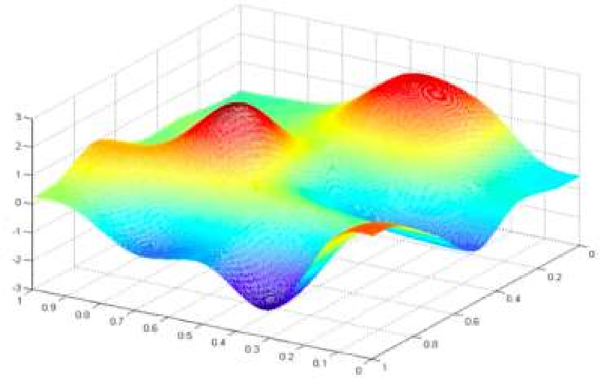
Core Foundation Review
The Perceptron
Neural Networks
Training in Practice
Structural building blocks
Nonlinear activation functions
Stacking Perceptrons to form neural networks
Optimization through backpropagation
Adaptive learning
Batching
Regularization

